Slide 1
Electric Vehicle Population Project

Slide 2
DATA DESCRIPTION
Data source explaining :
1) Dataset Name : Electric vehicle population data.csv
2) Context : A response model can provide a significant boost to the efficiency of a electric population by increasing sales or reducing expenses. The objective is to predict who will respond to an offer for a product or service

Slide 3
Content descriptions
VN(1-10) : Unique values
Country : Used country name
City : Used city Name
State : Used State
Postal code : unique residential number
Model year : Product making year
Make : company make name
Model : Specific name to electric vehicle

Slide 4
Electric vehicle type : Mode use for drive electric vehicle
Clean alternative Fuel vehicle : Its can used for clean alternative electric vehicle
Electric Range : drive km range full battery charge
Base MSRP : without RTO price
Legislative District : District
DOL Vehicle ID : the identifying code for a specific automobile
Vehicle Location : vehicle location place
Electric Utility : Power company
2020 Census Tract : permanent geographic entities within counties

Slide 5
Analysis the top 10 country have used electric vehicle:
County
King : 86594
Snohomish :19570
Pierce : 12972
Clark : 9847
Thurston : 6042
Kitsap : 5522
Spokane : 4312
Whatcom : 4039
Benton : 2028
Skagit : 1842
The King country has maximum used electric vehicle 86594 and Snohomish country is used
1957 electric vehicle.

Slide 6
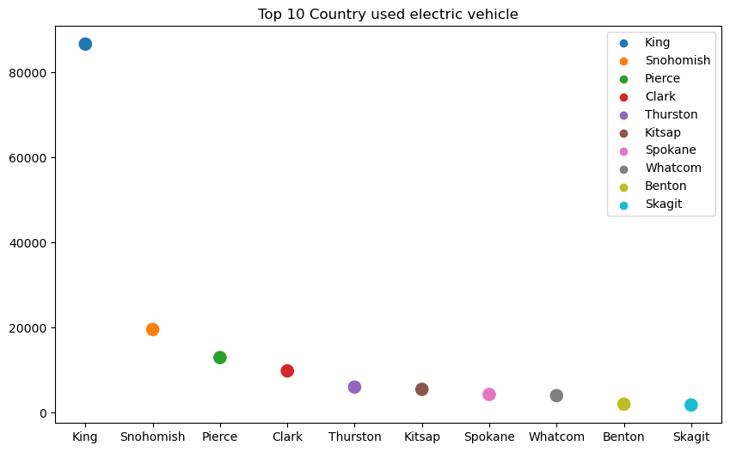

Slide 7
Analysis the king country Top 10 city is used most electric vehicle
City
Seattle : 27831
Bellevue : 8363
Redmond : 6032
Kirkland : 5028
Sammamish : 4876
Renton : 4617
Kent : 2602
Issaquah : 2597
Tukwila : 2324
Mercer Island : 2225
In the king country Seattle city has maximum electric vehicle and 2 nd was Bellevue has 8363 and so on...

Slide 8
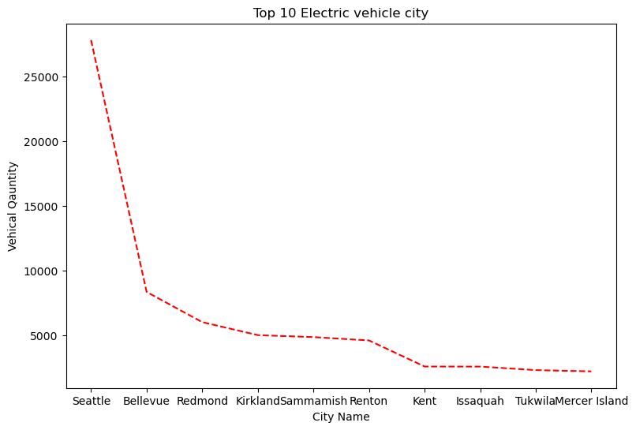

Slide 9
Analysis the which company make electric vehicle
'FIAT', 'TESLA', 'BMW', 'RIVIAN', 'CHRYSLER', 'CHEVROLET', 'KIA',
'FORD', 'TOYOTA', 'NISSAN', 'MITSUBISHI', 'HONDA', 'AUDI', 'JEEP',
'VOLVO', 'HYUNDAI', 'VOLKSWAGEN', 'SUBARU', 'LUCID', 'MINI',
'POLESTAR', 'SMART', 'LINCOLN', 'MERCEDES-BENZ', 'LEXUS',
'PORSCHE', 'ALFA ROMEO', 'DODGE', 'JAGUAR', 'CADILLAC’,
'LANDROVER', 'MAZDA', 'GENESIS', 'FISKER', 'GMC', 'TH!NK',
'WHEEGO ELECTRIC CARS', 'AZURE DYNAMICS', 'BENTLEY’
There are 39 company will make electric vehicle and TESLA and
BMW company is highest making electric vehicle .

Slide 10
Analysis by year electric vehicle most sales
2023 51350
2022 27591
2021 18774
2018 14150
2020 11425
2019 10859
2017 8519
2016 5518
2015 4833
2013 4454
2014 3539
2024 3309
2012 1630
2011 782
2010 23
2008 19
2000 7
1999 3
2002 2
1998 1
1997 1
2003 1

Slide 11
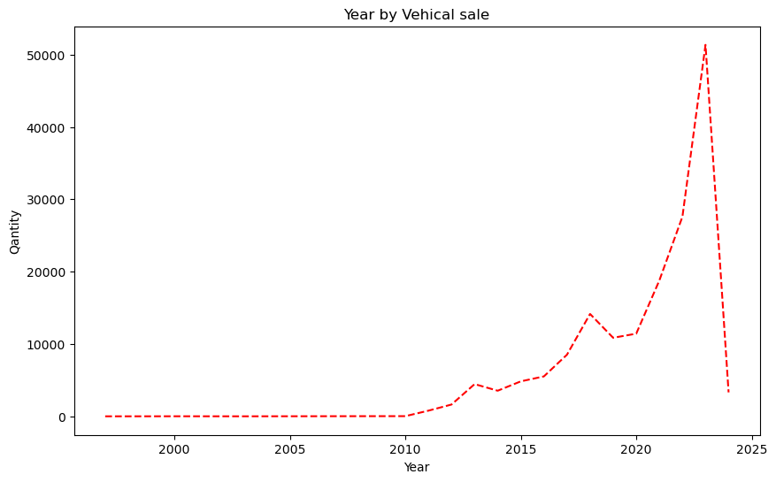

Slide 12
Analysis the model is most soled in data set with name and company make
Model
MODEL Y : 32822
MODEL 3 : 28925
LEAF : 13273
MODEL S : 7610
BOLT EV : 6412
MODEL X : 5428
VOLT : 4825
ID.4 : 3647
WRANGLER : 3160
MUSTANG MACH-E : 3107

Slide 13
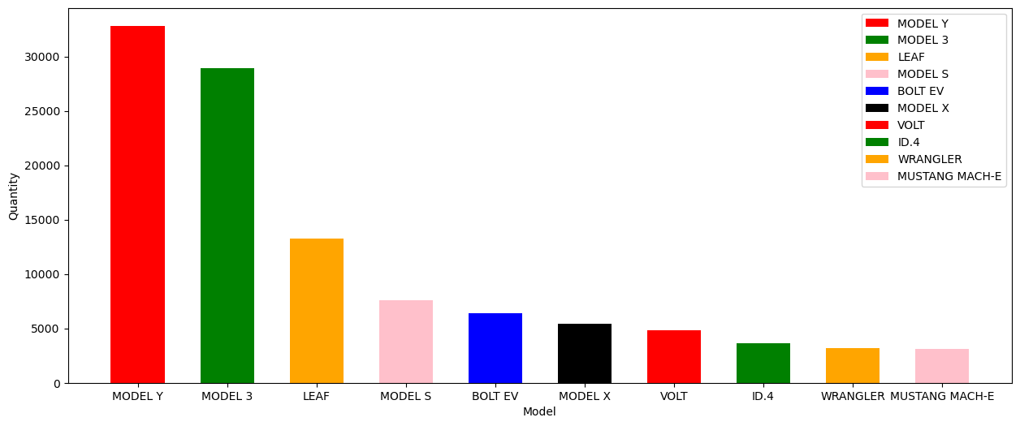
The tesla Model Y is most soled in 32822 quantity in market and model 3 is also soled 28925 quantity in market. The leaf model is also soled 13273 models.

Slide 14
Analysis the model make by tesla in year 2020
Model
MODEL 3 3556
MODEL Y 2335
MODEL X 672
MODEL S 392
The tesla make total model in 2020 year is 6955 and tesla company will make large
quantity of 3556 (MODEL 3) and 2335 (MODEL Y).

Slide 15
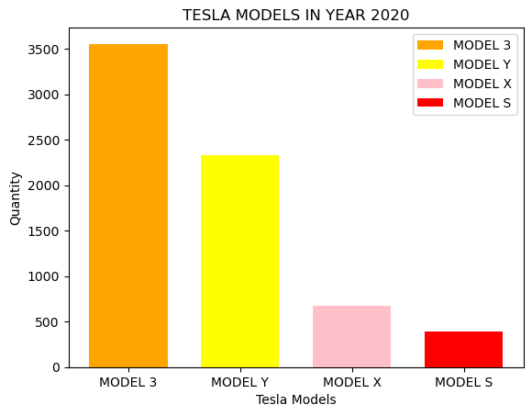

Slide 16
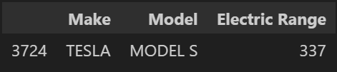
Analysis the electrical vehical has more electric range
The tesla company will make longest range of electric vehicle its range will 337
and its models was MODEL S.

Slide 17
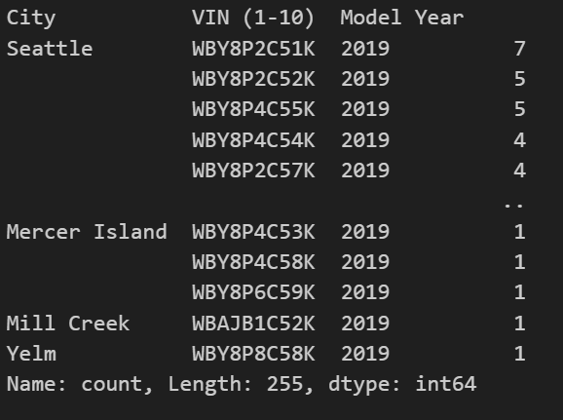
Analysis the sale done BMW in year 2019 with vehicle ID and city
There are 255 vehicle soled by BMW in 2019 and its most vehicle soled in the Seattle city.

Slide 18
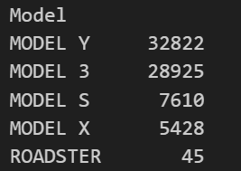

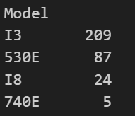


Compare the Tesla company and BMW company
Tesla : Electric Range : Total Quantity:
BMW : Electric Range : Total Quantity :

Slide 19
We compare BMW and TESLA on the sale , model present in market and electric range . TESLA soled total electric vehicle 74830 and BMW sold total electric vehicle 7196 . In the market TESLA have 5 model present MODEL Y & MODEL 3 best seller vehicle its sales 32822 & 28925 and BMW have 14 models present in market its X5 & I3 is famous vehicle its sale is 2301 & 1919 . Tesla have maximum electric range was 337 and BMW is 153.

Slide 20


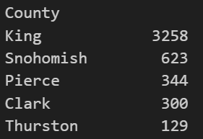

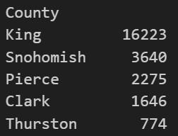
Comparing the tesla model 3 and model x of tesla
Model X : Electric Range : Top 5 Country :
Model 3:

Slide 21
We compare the MODEL X and MODEL 3 on Electric range, total sold & country wise. MODEL X sold Quantity of 5428 and MODEL 3 is sold quantity of 28925.The electric maximum range of MODEL X is 293 and MODEL 3 was 322 . Both are sold in same country king ,Snohomish but quantity is different MODEL X is 3258 and model 3 is 16223. Model 3 is best performance in the market.

Slide 22
Analysis by city wise purchased maximum electrical vehicle
City
Seattle : 27831
Bellevue : 8364
Redmond : 6032
Vancouver : 5869
Bothell : 5440
Kirkland : 5028
Sammamish : 4876
Renton : 4617
Olympia : 4058
Tacoma : 3510
The Seattle city purchased maximum electrical vehicle 27831 and Bellevue is purchased 8364 vehicle. Redmond is also purchased 6032 vehicle and so on...

Slide 23
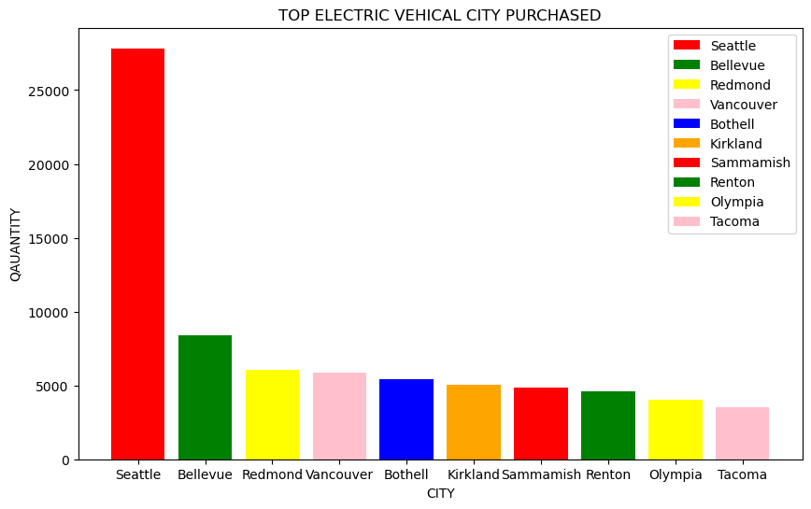

Slide 24
Analysis by the year wise sale of electric vehicle of company Tesla
Model Year
2023 :24979
2022 :13707
2021 :10890
2018 :7752
2020 : 6955
2019 :4713
2017 : 1606
2016 :1587
2015 :1082
2013 :746
2014 :644
2012 :124
2010 :20
2008 :19
2011 : 6

Slide 25
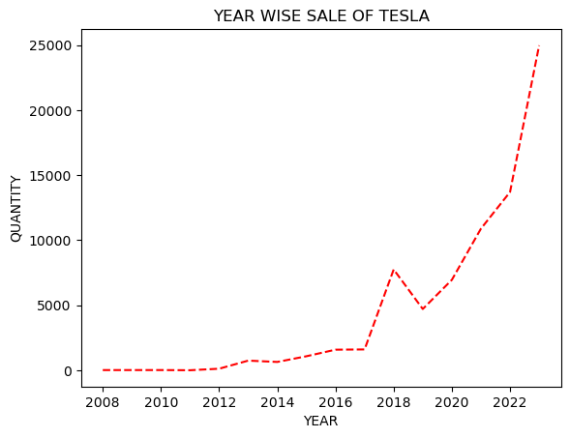
In the 2023 achieve good sale he was sold 24979 vehicle and 2022 achieve sale of 13707 vehicle. In 2021 achieve sale 10890 vehicle by tesla . Tesla sale year by year grow up.

Slide 26
Analysis by the year wise sale of electric vehicle of company Nissan
Model Year
2013 1890
2015 1785
2019 1376
2023 1286
2018 1210
2016 1120
2022 948
2017 915
2011 690
2021 687
2020 686
2014 646
2012 567
2024 41

Slide 27
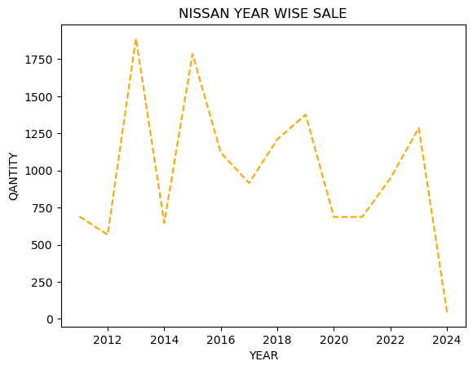
The Nissan company sale was going down year by year. The highest sale of Nissan in 2013 of 1890 vehicle .In the 2023 only 1286 vehicle only. Its huge issue.

Slide 28
Analysis by the year wise sale of electric vehicle of company Ford
Model Year
2023 :2434
2022 :1716
2021 :900
2016 :757
2017 :637
2013 :607
2014 :589
2015 :530
2018 :164
2019 :148
2020 :72
2012 :12
2000 :7
1999 :3
1998 :1

Slide 29
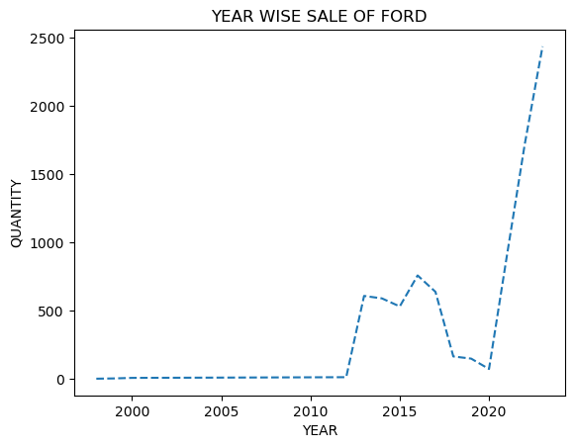
The ford company sale 2434 vehicle in 2023 and in 2022 ford sale 1716 vehicle and the sale graph going upward year by year.

Slide 30
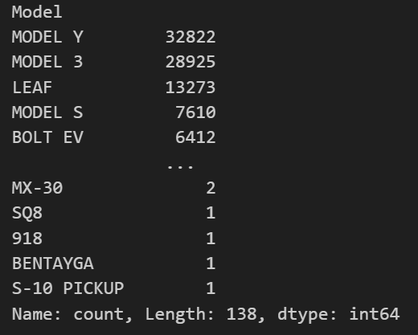
Analysis the which model will preferred to buying
The Model preferred maximum client is MODEL Y of 32822 vehicle tesla company and also preferred MODEL 3 by 28925 customer and so on..

Slide 31
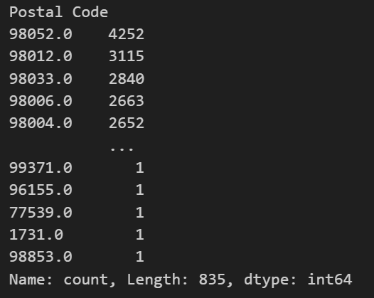
Analysis by postal code buy maximum electric vehicle
The postal code 98052 buy maximum electric vehicle of 4252 and also postcode 98012 is buy electric vehicle 3115 and so on.

Slide 32
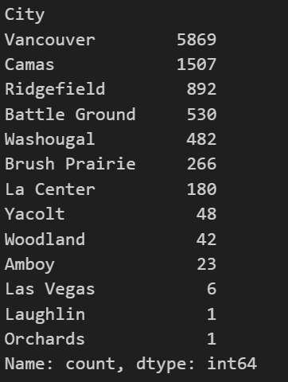
Analysis by the Clark country city wise sale :
In the Vancouver city large amount electric vehicle is sold 5869 and Camas city also purchase maximum vehicle of electric 1507 and list given below.

Slide 33
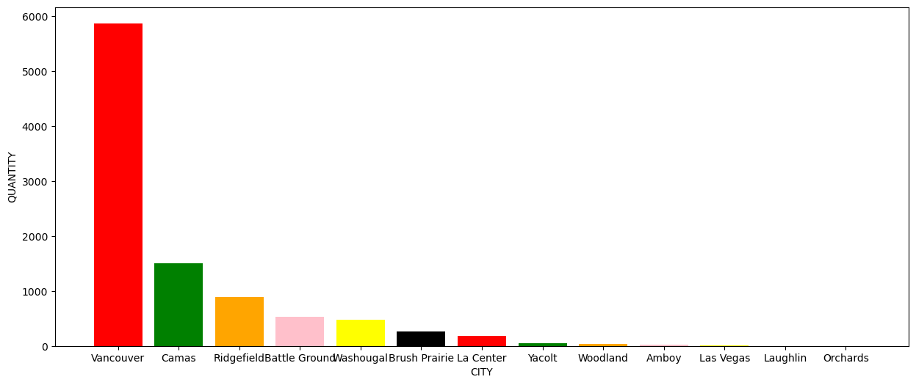

Slide 34
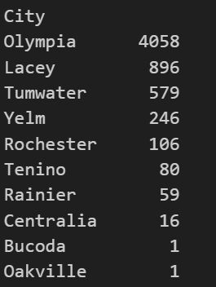
Analysis by the Thurston country city wise sale
In the Thurston country Olympia has purchased maximum 4058 electric vehicle and lacey
is purchased 896 electric vehicle.

Slide 35
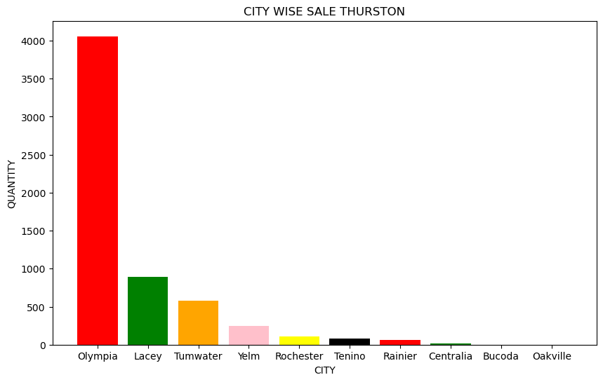

Slide 36
Analysis by the Snohomish country city wise sale
Bothell : 4327
Lynnwood : 2537
Everett : 2312
Snohomish : 1975
Edmonds : 1767
Lake Stevens : 1231
Marysville : 1111
Mukilteo : 737
Monroe :723
Mill Creek : 651
Arlington : 540
Mountlake Terrace : 419
Stanwood : 393
Brier : 208
Woodinville : 183
Sultan : 159
Granite Falls : 138
Woodway : 87
Gold Bar : 53
Darrington : 9
Tulalip : 4
Index : 3
Shoreline : 1
Alderwood Manor : 1
Startup : 1

Slide 37
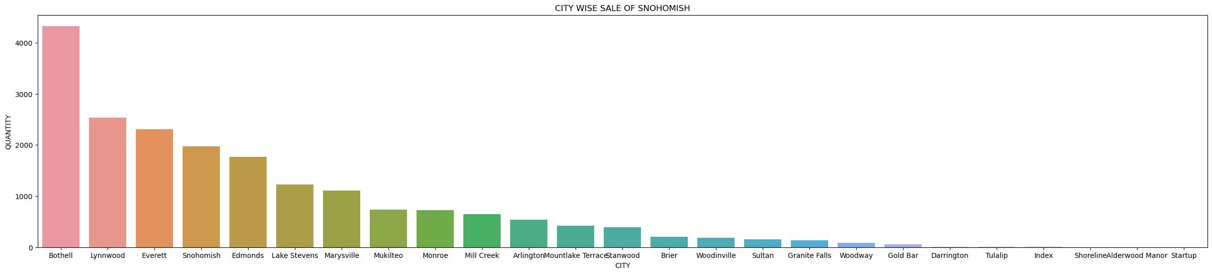
In country Snohomish in city Bothell purchased vehicle 4327 and in city Lynnwood purchased maximum vehicle 2537.

Slide 38
Analysis by the Top 10 state has use maximum electric vehicle
    State
    WA : 166435
    CA : 91
    VA : 38
    MD : 32
    TX : 24
    NC : 14
    IL : 13
    CO : 12
    FL : 10
    HI : 9
The WA has maximum preferred to buying electric vehicle 166435 .

Slide 39
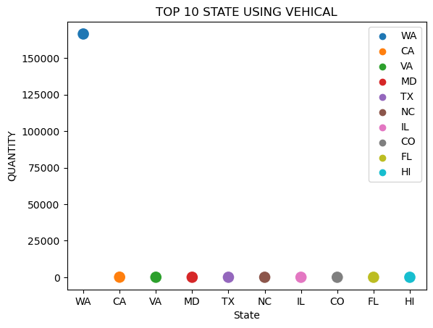

Slide 40
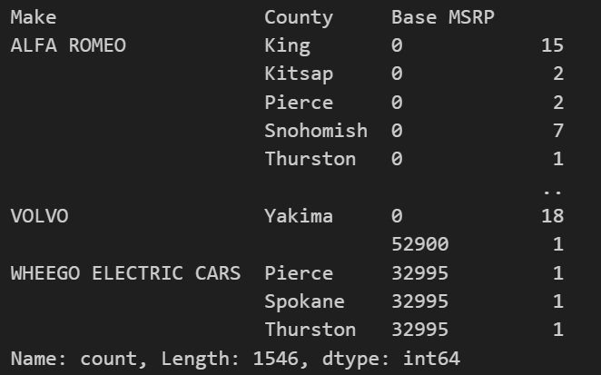
Analysis by the manufacture company make sale country wise

Slide 41
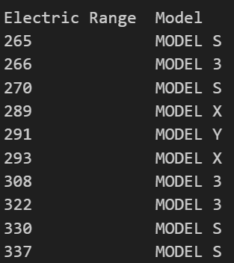
Analysis the electric vehicle give a best milage
In the given data Model is MODEL S is best for electric range .

